Slide 1
Technology Transformation Project
Patrick Desbrow
Measure Phase Tollgate Review

Slide 2
BPM Project Summary
Problem Statement
The Client System Group (CSG) spends approximately 277 hours or $25,000 to deliver a single study on the existing Compass web deliverable.
There are too many individual steps in a single study. The existing process is manual and requires a great deal of checking to ensure accuracy. In addition, it is also susceptible to errors and potential rework.
Metric
Y1: Labor hours per syndicated study
Defect Definition
D1: Total time > Labor Hours
D2: # of Errors
Objective
Currently a syndicated study in the Insurance practice area takes approximately 277 hours of IT labor to deliver on the Compass web site. The aim is to:
  Decrease this by 72% or 200 hours of labor for a syndicated research study.
Current Baseline
Average labor hours for creating and checking study deliverables: 277 labor hours
2.0 person programming teams work on each study implementation
All hardware and software costs are part of the Solution Framework project
Projected Benefits
Based on project chargeback rates per hour, There will be a cost saving of $15,433 per study implementation
There is at least $100,000 savings if only seven to nine current insurance practice area studies move over to this new process
Copyright © 2001-2007
Six Sigma Academy International, LLC
All Rights Reserved
JDPA – Insurance Practice Business Process Redesign

Slide 3
Measure Key Accomplishments
Defined a set of quick wins for the project
Developed a statement of work that focuses on the area for improvement
Completed data collection and established baseline performance
Completed review of the preliminary business case with I&M Finance
Completed EA&EC and Tech Ops approval process for the Compass Portal / Business Center Project
Developed a detail project plan including BPM Milestones and Core Team meeting updates
Copyright © 2001-2007
Six Sigma Academy International, LLC
All Rights Reserved
JDPA – Insurance Practice Business Process Redesign
Notes:
The initial project charter was still rather broad – identifying a need for improvement within the broad spectrum of executing a mail-based study. In that regard, it was important for us to walk through the process and talk to process owners, practice leads, and research project managers to identify the key stakeholders and internal customers. This helped us understand the pain points throughout the process
From the walk-through and interviews, we learned a few things:
1. The existence of a number of handoffs and verification steps that have been institutionalized in our processes
2. An understanding of how scope of work changes and input variation impact our Client Operations (i.e. research production) activities, and
3. The type of data available and necessary for us to gather and analyze in order to prioritize our pain points

Slide 4
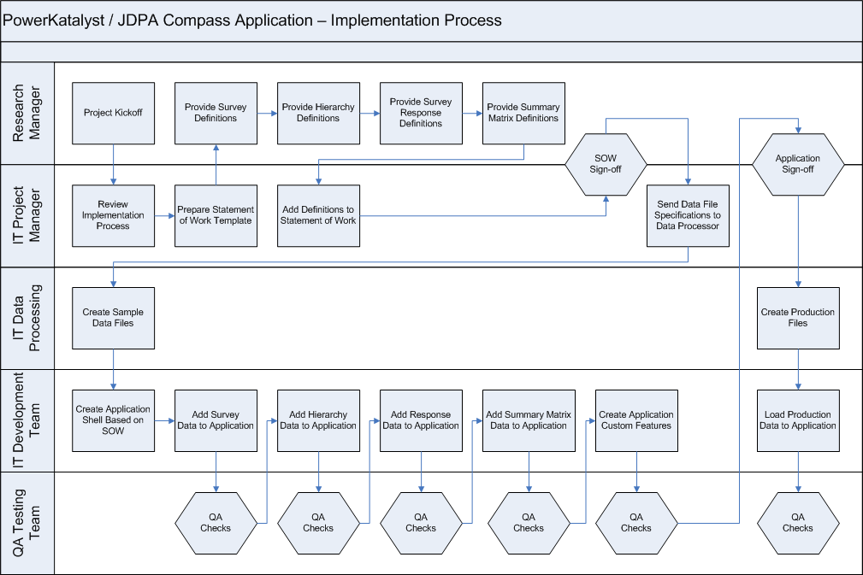
Detail Process Map
1
2
3
4
5
= Opportunities
Copyright © 2001-2007
Six Sigma Academy International, LLC
All Rights Reserved
JDPA – Insurance Practice Business Process Redesign
Notes:
The initial project charter was still rather broad – identifying a need for improvement within the broad spectrum of executing a mail-based study. In that regard, it was important for us to walk through the process and talk to process owners, practice leads, and research project managers to identify the key stakeholders and internal customers. This helped us understand the pain points throughout the process
From the walk-through and interviews, we learned a few things:
1. The existence of a number of handoffs and verification steps that have been institutionalized in our processes
2. An understanding of how scope of work changes and input variation impact our Client Operations (i.e. research production) activities, and
3. The type of data available and necessary for us to gather and analyze in order to prioritize our pain points

Slide 5
Opportunities
Creating the Project Statement of Work
    Each project can have a high degree of customization
    This requires a detail project requirements document or SOW
    This document is design to control scope and reduce variations between studies
    The project aims to eliminate the need for a detailed statement of work process
Adding Survey Questionnaire Information to Application
    Programmers currently needs to manually setup survey questionnaire data
    This step begins with the instructions provided by the research project team
    Programmers then map and format the survey questions
    This process may go through a number of cycles
Adding Hierarchy Data to Application to Application
    Programmers currently need to manually load the study hierarchy information
    Programmers map and format this data as well
    This process also goes through a number of cycles
Copyright © 2001-2007
Six Sigma Academy International, LLC
All Rights Reserved
JDPA – Insurance Practice Business Process Redesign

Slide 6
Opportunities
Adding Summary and Detail level to Application
    Programmers currently need to manually load the respondent level data
    and summary data such as index scores
    Programmers map and format this data as well
    This process also goes through a number of cycles
Numerous QA Testing Checks Through the Process
    There is a quality assurance test step for each of these manual processes
    The aims is to reduce the amount of testing before a study is delivered
Copyright © 2001-2007
Six Sigma Academy International, LLC
All Rights Reserved
JDPA – Insurance Practice Business Process Redesign

Slide 7
Measurement System Analysis
Measurement
Component
Risk
Labor hours are captured at the project and task level for all compass projects reviewed
Errors can be created if a resource selects the wrong project or wrong task code
Resolution
Low
There is a high level of level of consistency in the data capture process
Data has been collected for 20 compass implementations using the same tools
The same technology resources have been working on all of these projects
However, the level of complexity of the project varied depend on the study
As a result, some of the labor hours where about the 277 target and some where below the 277 target
Accuracy
Med/High
Labor hours are self reported and could be either understated or overstated
Training is conducted on a quarterly basis to ensure correct procedures are followed
One-on-one training is conducted for new resources or if an issue is found
Precision
Med/High
This analysis is conducted on 20 studies. JDPA will be increase the number of implementations to over 100 in 2009.
The analysis should be reviewed quarterly to ensure the target remains valid
Copyright © 2001-2007
Six Sigma Academy International, LLC
All Rights Reserved
JDPA – Insurance Practice Business Process Redesign

Slide 8
Measurement System Analysis
An audit was conducted on the 2007/2008 Compass study labor hours recorded in JDPA timekeeping tool called Timepiece
Objective: validate the system used to record and allocate project labor
The actual labor hours recorded were compared against the 277 hour Forecast hours by project and task code. The Forecast is an labor estimate that was created based on first 5 study published on the Compass platform. However, this average has held up across 20 additional studies
Each person on the project enters there labor hours into the JDPA timekeeping tool
  Sector Leaders/Managers meet each month to discuss and analyze end of month labor hour actuals
  Sector Leaders/Managers are learning about labor hour drivers and continue to improve forecasting competencies and discipline
Current procedures and practices ensure that the labor hours recorded are valid
  The existing timesheet approval process enables Managers to validate labor hours recorded and allocated to projects by Associate
  Managers view the activities reported by their direct report Associates every week
  Managers ensure direct report Associates do not understate or overstate the actual number of labor hours worked (i.e. labor over 40 hours are recorded; overtime is monitored)
    Some managers record their own detailed tasks on a daily basis and use this as a gauge to monitor their direct report Associates’ activities
  Utilization metrics and reporting creates incentive not to “hide” labor hours as ‘Operating Expenses’
Copyright © 2001-2007
Six Sigma Academy International, LLC
All Rights Reserved
JDPA – Insurance Practice Business Process Redesign

Slide 9
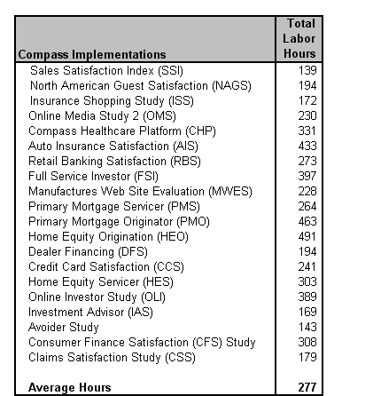
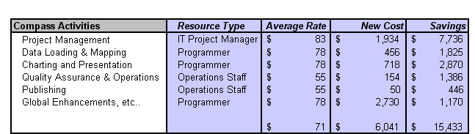
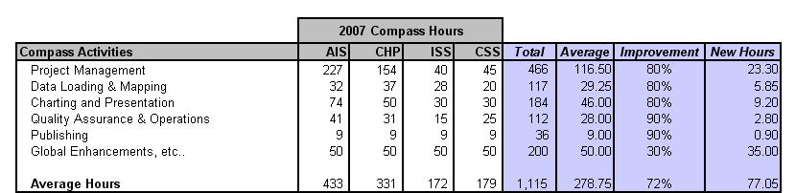
Baseline Data
1.
3.
There will be a cost saving of $15,433 per study implementation
An average of 277 hours are spent on activities related to compass implements
2.
Project Management, Data Loading, and Presentation tasks are the drivers of cost
Source: Full labor hours capture through Timepiece. Contract labor hours captured through ActTime
Copyright © 2001-2007
Six Sigma Academy International, LLC
All Rights Reserved
JDPA – Insurance Practice Business Process Redesign
Notes:
The initial project charter was still rather broad – identifying a need for improvement within the broad spectrum of executing a mail-based study. In that regard, it was important for us to walk through the process and talk to process owners, practice leads, and research project managers to identify the key stakeholders and internal customers. This helped us understand the pain points throughout the process
From the walk-through and interviews, we learned a few things:
1. The existence of a number of handoffs and verification steps that have been institutionalized in our processes
2. An understanding of how scope of work changes and input variation impact our Client Operations (i.e. research production) activities, and
3. The type of data available and necessary for us to gather and analyze in order to prioritize our pain points

Slide 10
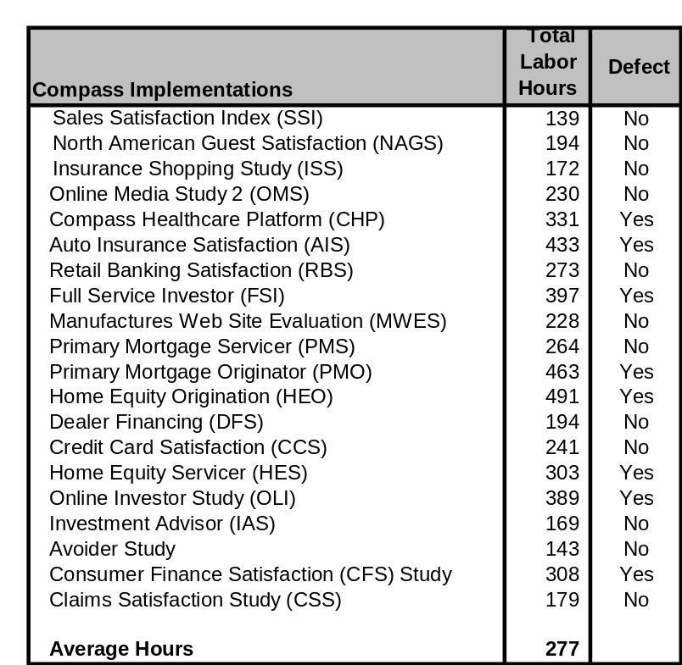
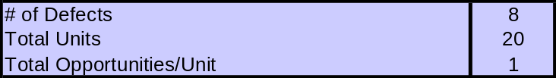
Baseline Performance
DPMO = No. of Defects / (Total Units X Total Opportunities per Unit) x 1,000,000
= (8 / (20 x 1)) x 1,000,000 = 400,000
Sigma level = 1.8
Copyright © 2001-2007
Six Sigma Academy International, LLC
All Rights Reserved
JDPA – Insurance Practice Business Process Redesign

Slide 11
Quick Wins
A quick win was identified that would reduce data checking labor beginning in 2008
  The research Group will create a create a set discrepancy reports for the Research project teams to validate the data process efforts.
  Benefits
    This will eliminates the requirement for research project teams independently re-create data processing deliverable (dual processing)
    This will reduces the time and effort required to validate the DP deliverables
  This quick is expected to be applicable across all practice areas
    All practices areas have at least one Compass deliverable
    Each of these groups will benefit from the use of discrepancy reports
Copyright © 2001-2007
Six Sigma Academy International, LLC
All Rights Reserved
JDPA – Insurance Practice Business Process Redesign
Notes:
The initial project charter was still rather broad – identifying a need for improvement within the broad spectrum of executing a mail-based study. In that regard, it was important for us to walk through the process and talk to process owners, practice leads, and research project managers to identify the key stakeholders and internal customers. This helped us understand the pain points throughout the process
From the walk-through and interviews, we learned a few things:
1. The existence of a number of handoffs and verification steps that have been institutionalized in our processes
2. An understanding of how scope of work changes and input variation impact our Client Operations (i.e. research production) activities, and
3. The type of data available and necessary for us to gather and analyze in order to prioritize our pain points

Slide 12
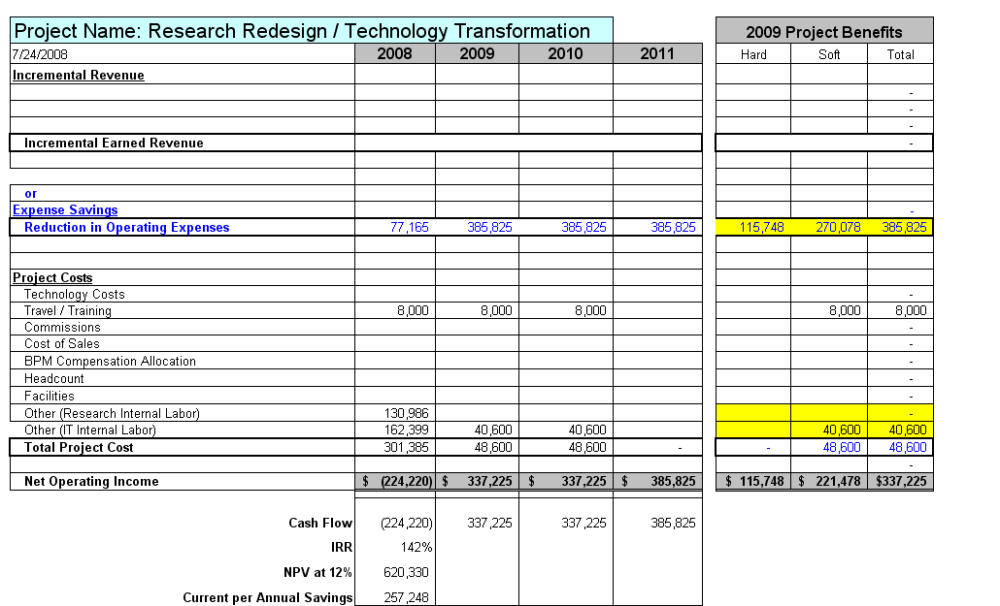
JDPA Business Case Summary
Copyright © 2001-2007
Six Sigma Academy International, LLC
All Rights Reserved
JDPA – Insurance Practice Business Process Redesign

Slide 13
Assumptions
Labor Improvement Assumptions
Improvement in IT labor hours (72%) associated with the following activities:
  Reducing project management
  Eliminating data loading tasks
  Reduce chart creating and presentation tasks
Cost Savings Assumptions
Reduce labor by 200 hours per project
$15,433 cost saving per study
5 projects in 2008, 25 project each year after
Resource Assumptions
No additional Insurance practice labor hours/costs after 2008
There will be additional IT development costs in 2008 & 2009 related to efforts for other practice areas
30 % of the contract resources will be retired resulting in a hard cost saving of $115,748 in 2009.
All other resources will moved to other projects
Other Assumptions
Travel: $1000/trip x 2 trips x 2 employees = $4,000
Training: $1,000/session x 4 sessions = $4,000
No software or hardware costs. (These costs are part of the Solution Framework project)
Copyright © 2001-2007
Six Sigma Academy International, LLC
All Rights Reserved
JDPA – Insurance Practice Business Process Redesign

Slide 14
Next BPM Steps
Move onto the Analyze phase
Refine detailed process maps
Validate quick win
Outline new process steps and activities
Copyright © 2001-2007
Six Sigma Academy International, LLC
All Rights Reserved
JDPA – Insurance Practice Business Process Redesign
Notes:
The initial project charter was still rather broad – identifying a need for improvement within the broad spectrum of executing a mail-based study. In that regard, it was important for us to walk through the process and talk to process owners, practice leads, and research project managers to identify the key stakeholders and internal customers. This helped us understand the pain points throughout the process
From the walk-through and interviews, we learned a few things:
1. The existence of a number of handoffs and verification steps that have been institutionalized in our processes
2. An understanding of how scope of work changes and input variation impact our Client Operations (i.e. research production) activities, and
3. The type of data available and necessary for us to gather and analyze in order to prioritize our pain points

